Slide 1
Reading strategies for Honours

Slide 2
Key message
Take systematic notes
Ask yourself questions as you read
Read:
Often
With a purpose
Using the 4S system
Write early and write often

Slide 3

Shows your familiarity with the field
Justifies your project's aims, approach and importance
Discussion
Explains why your research contributes to the field
Intro and literature review
Methods
Justifies why you use these methods
Research journal
Read early and read often
Helps to develop your thesis
Notes:
This is where your reading will be most useful in your assessment – Research journal and thesis

Slide 4
Research journal
Goal: To get you reading papers relevant to your project and thinking critically about them.
Each week, you will write a 1-2 page (750 word) summary of a paper addressing the questions on the last slide
It will require at least a full read of the paper, a few hours of work
Get your supervisor to help you choose an appropriate range of articles. E.g. Letter, full article, high profile article, etc
Do not paraphrase the abstract. You must provide a link to the paper, and I will read the abstract.

Slide 5
Assessment criteria
I’m looking that you:
Have identified the key information of the paper
Have put the work in the context of the field
Have produced a clear summary suitable for a general physics audience
Have generated new understanding relevant to your project.

Slide 6
Requirements
Up to 750 words
The subject should be a journal article of 4-20 pages.
Must include the full reference to the paper, and a link to the abstract (if this is not available online, attach the abstract to the journal entry)
There is a latex and a word template, and some examples online.

Slide 7
Three important facts
Scientists read a lot of papers​
Reading papers is hard​
Reading and note-taking strategically is key to dealing with the load

Slide 8
Scientists read a lot of papers​
To:​
Learn new physics concepts​
To keep up-to-date with the field​
To extract results/parameters they need​
To repeat or extend the research in a paper​

Slide 9
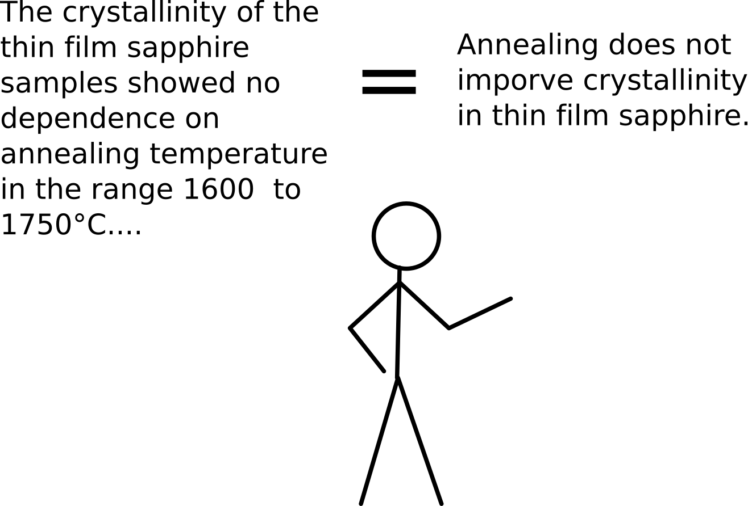
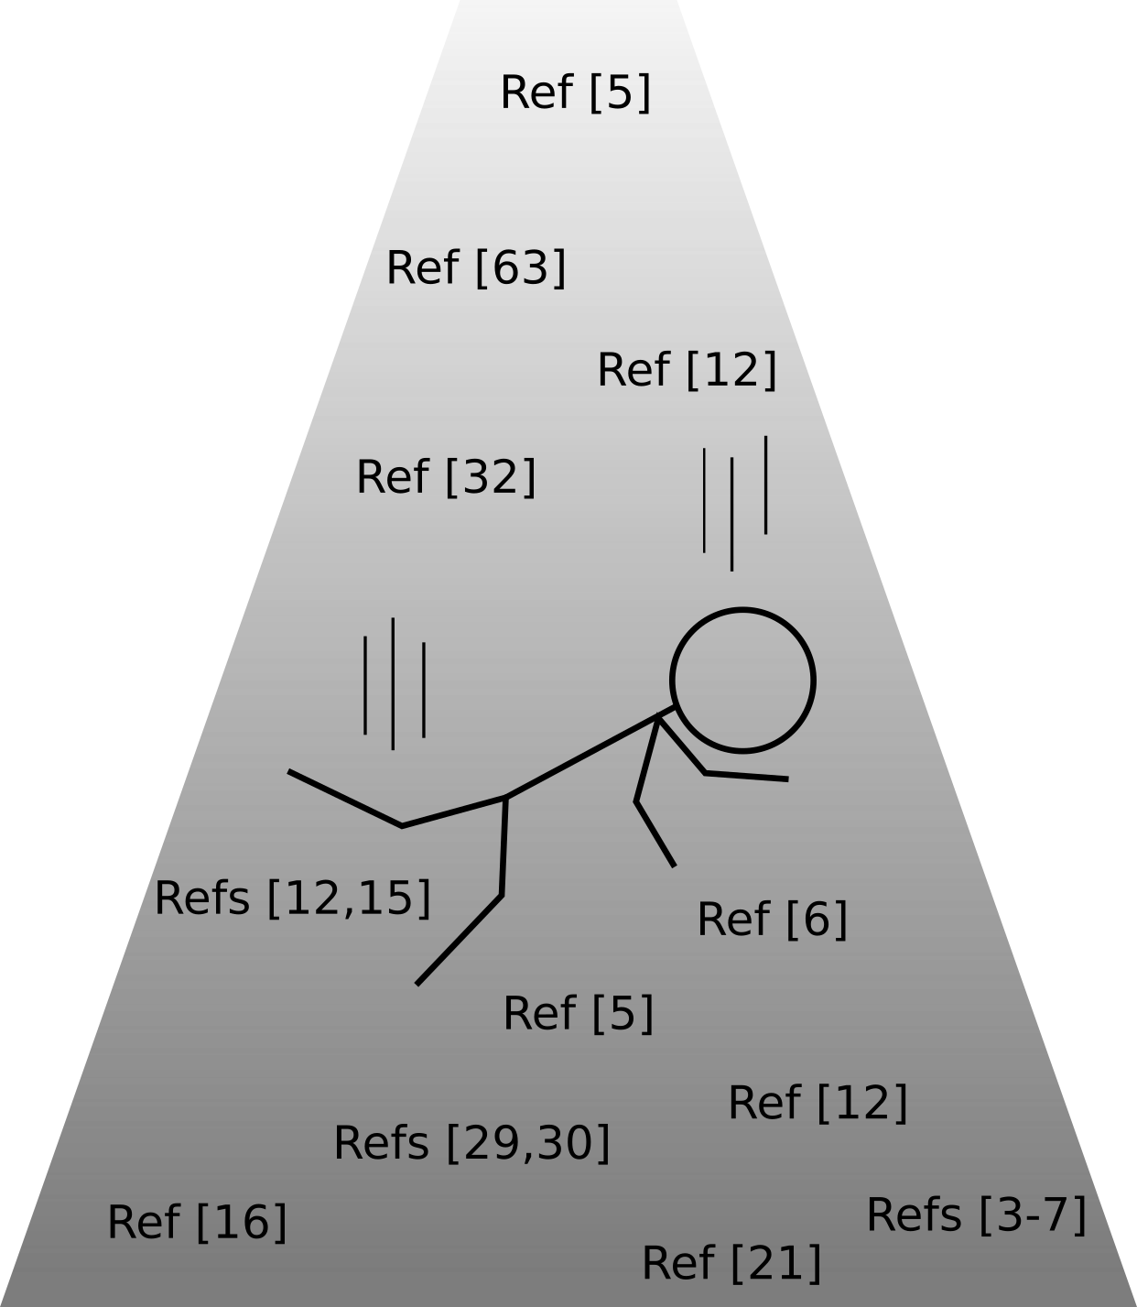
Why is reading Physics papers hard?
The misunderstanding
The rabbit hole
Notes:
Because:​
They are information-dense​
They contain concepts and language you are not familiar with​
They may not directly address your problem​
They can be poorly written​
Results or interpretation may be incomplete or incorrect​
​

Slide 10
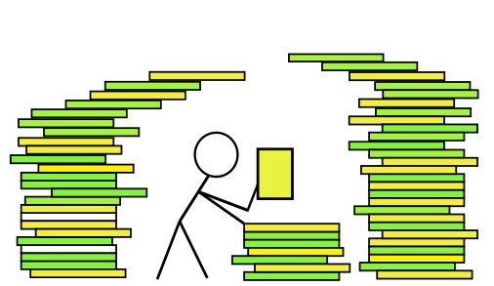
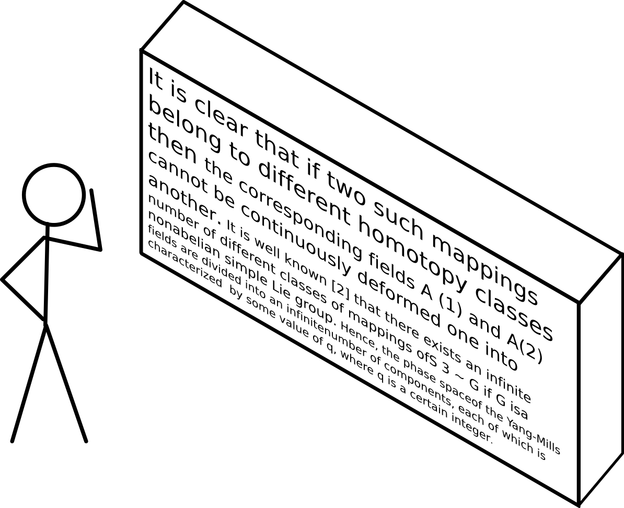
Why is reading Physics papers hard?
The brick wall
FOMO
Notes:
Because:​
They are information-dense​
They contain concepts and language you are not familiar with​
They may not directly address your problem​
They can be poorly written​
Results or interpretation may be incomplete or incorrect​
​

Slide 11
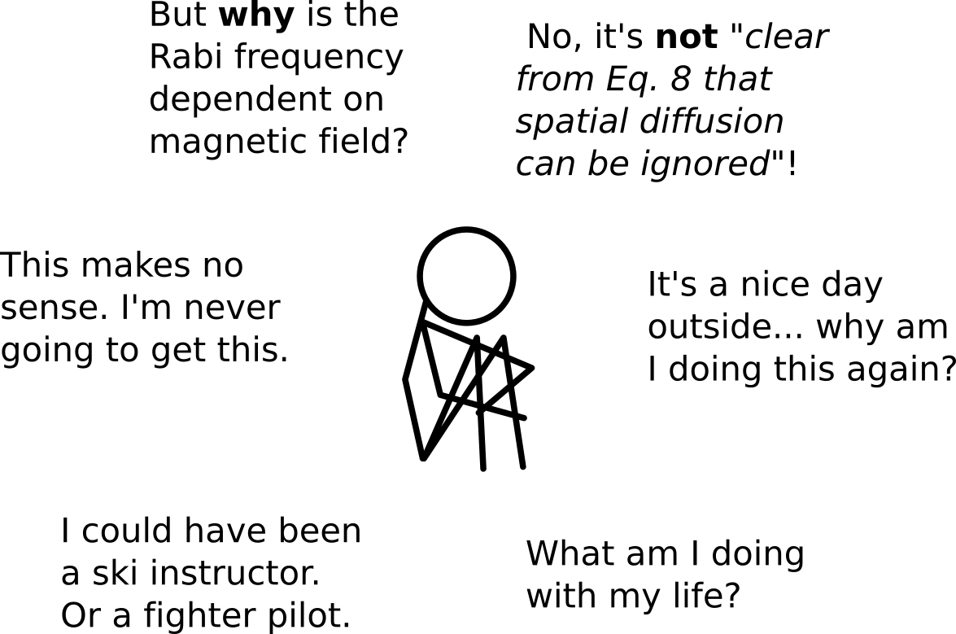
Why is reading Physics papers hard?
The existential crisis
Notes:
Because:​
They are information-dense​
They contain concepts and language you are not familiar with​
They may not directly address your problem​
They can be poorly written​
Results or interpretation may be incomplete or incorrect​
​

Slide 12
PURPOSE
Why am I reading this?
What information do I need?
How much time and energy is it worth?
Always have a question!
Notes:
To manage the load, you need to read with a purpose

Slide 13
Honours reading: many purposes...
Which studies are most relevant to mine?
Which methods are used?
What have others found?
What have people not done?
What are the problems in the field?
How do others interpret these results?
Background info
Hmm this is interesting...
… take notes to suit these purposes
Notes:
You’ll do lots of reading in Honours, for different purposes

Slide 14
3-pass method for reading a paper
Quick read (10 mins): get the gist of the paper
Full read (few hours): gain general understanding of the whole paper
Detailed read (few hours to one day): completely understand paper, critically analyse all assumptions, results, and conclusions

Slide 15
Application

Slide 16
1. Search
2. Skim
3. Select
4. Study
PURPOSE – Why am I reading this? What information do I need? How much time and energy is it worth?

Slide 17
Identify your reading purpose
Questions for a quick read
First:
What is the key information of the paper?
What is the context of the field?
How does the paper contribute to the field?
Notes:
These are broad questions for a quick read.
Harder questions for this paper can include:
How compelling are the findings?
Why do the authors say the FLG is a mixed carrier?
Why do they say the electronic transportations are 2D?
What do the oscillations suggest?
Why might single-layer graphene be a zero-gap semiconductor?

Slide 18
1. Search
How is the article laid out? What are the sections?
PURPOSE – Why am I reading this? What information do I need? How much time and energy is it worth?

Slide 19

Activity 1: Search out the structure
Quickly look at the way the article is structured
How easy will it be to find the answers to the questions?
What is the key information of the paper?
What is the context of the field?
How does the paper contribute to the field?
Notes:
Handout the article and ask them to search for the structure. Discuss what they are looking for – how the article is laid out, what type of document is it? Read the section headings only.

Slide 20
2. Skim
What are the key ideas in the abstract, key words, intro, headings, topic sentences?
PURPOSE – Why am I reading this? What information do I need? How much time and energy is it worth?
Notes:
Now we know WHY we are reading, next we need some strategies to deal with the actual reading. These strategies will be very helpful as you are developing your reading skills and adapting to reading material in English
We are going to look at each one closely based on the article “We don’t leave our identities at the city limits’: Aboriginal and Torrens Straight Islander people living in urban localities”

Slide 21

Activity 2: Skim the text
Skim the key sections
Will they help you to answer the questions?
What is the key information of the paper?
What is the context of the field?
How does the paper contribute to the field?
Notes:
Apply the skimming techniques to the reading. When skimming you might want to highlight things such as: the argument, key terms or ideas in the topic sentences and conclusions
Discuss at the end how they found this process – do they feel they have a better overview? Was this very easy? Which parts were more difficult, and how would you approach those sections?

Slide 22
Handy hint – use topic sentences to work out the structure
Intro
The ability to control electronic properties of a material by externally applied voltage is at the heart of modern electronics.
We report the observation of the electric field effect in a naturally occurring two-dimensional (2D) material referred to as few-layer graphene (FLG).

Slide 23
Handy hint – use topic sentences to work out the structure
Methods
We have been able to prepare graphitic sheets of thicknesses down to a few atomic layers (including single-layer graphene), to fabricate devices from them, and to study their electronic properties
Our graphene films were prepared by mechanical exfoliation (repeated peeling) of small mesas of highly oriented pyrolytic graphite (15).

Slide 24
Handy hint – use topic sentences to work out the structure
Results and discussion
In FLG, the typical dependence of its sheet resistivity D on gate voltage V_{g} (Fig. 2) exhibits a sharp peak …
Our measurements can be explained quantitatively by a model of …
Without electric field doping (at zero V_{g}), FLG was found to be a hole metal, which is seen as …
Carrier mobilities in FLG were determined from …
Despite being … FLG films exhibit pronounced Shubnikov–de Haas (ShdH) oscillations …
We also determined the band overlap …

Slide 25
Handy hint – use topic sentences to work out the structure
Conclusion and future directions
Graphene may be the best possible metal for metallic transistor applications.

Slide 26
3. Select
Which sections or paragraphs are relevant to me?
PURPOSE – Why am I reading this? What information do I need? How much time and energy is it worth?
Notes:
Now we know WHY we are reading, next we need some strategies to deal with the actual reading. These strategies will be very helpful as you are developing your reading skills and adapting to reading material in English

Slide 27

Activity 3: Select the text
Which sections are relevant to the questions:
What is the key information of the paper?
What is the context of the field?
How does the paper contribute to the field?
Notes:
If you've already found the answers to the broad questions from your skim read, more specific questions could be:
How compelling are the findings?
Why do they say the FLG is a mixed carrier?
Where would you find the evidence for why single-layer graphene might be a zero-gap semiconductor?

Slide 28
4. Study
Closely read the relevant parts and take notes
PURPOSE – Why am I reading this? What information do I need? How much time and energy is it worth?

Slide 29

Read actively: engage!
Question the text
What is the key point here?
Why do the authors say this?
Does it make sense? Why/why not?
What do I need to find out next?
Take notes
Notes:
Now that we’ve identified the sections to read closely, we need to look at how to read the text ACTIVELY. Think about the questions you have been set but also be critically evaluating it. Ask questions. Is the reasoning valid? Have they used enough credible evidence? Are you convinced by the argument? Does it match with what you already know? What other authors say? Etc.

Slide 30

Activity 4: Study the text
Pick the paragraph on p. 668 that is relevant to the question:
What evidence do they have to say the electronic transport is strictly 2D?
Additional questions
Why do they say the FLG is a mixed carrier?
Where would you find the evidence for why single-layer graphene might be a zero-gap semiconductor?
Read the section closely and take notes
What are the key ideas?
Could you test assumptions?
Could you identify alternate explanations?

Slide 31
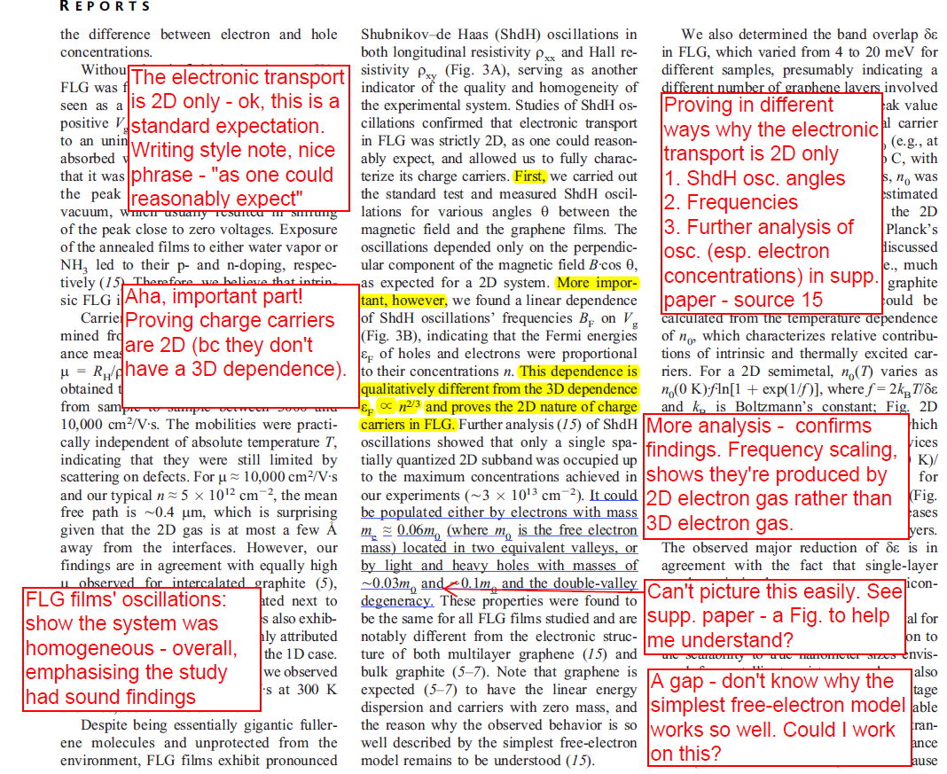
What evidence do they have to say that the electronic transport is strictly 2D?

Slide 32
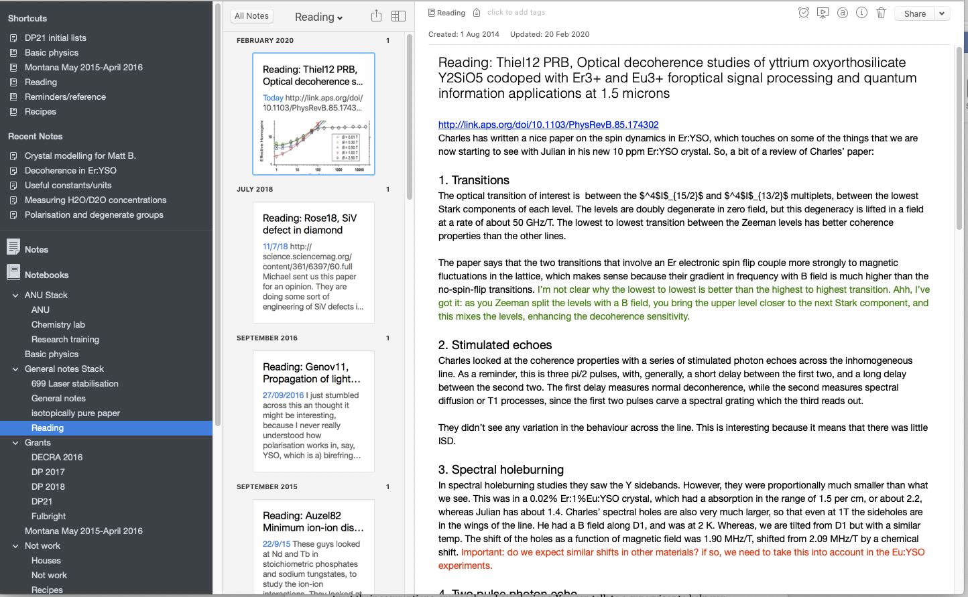
Rose's notes

Slide 33
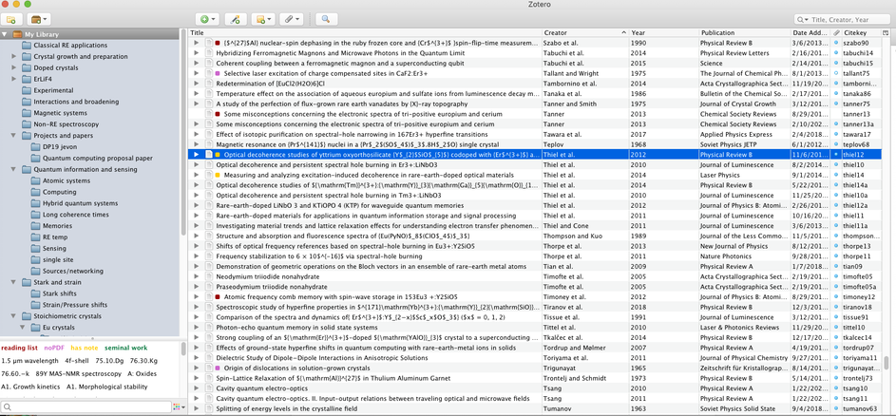
Rose's notes

Slide 34




Take systematic notes

Slide 35
Use a system to compare your notes
Ref | How relevant is this to my work? | Aims | Key findings | Approach | My questions & tasks | Comparison to other studies | Etc.
Source 1 | Slightly different approach to mine |  |  |  | Why don't they …? Need to follow up. | Similar to source 2's approach but ...
Source 2 | Similar to my approach, very convincing conclusions |  |  |  | Find their more recent studies

Slide 36
Cue column – your ideas
Notes column – authors’ key points
How does this fit in to other research in the field?
Why is this study important?
How valid is the approach?
How strong/compelling is the evidence?
How logical is the rationale for the key findings?
Aim
What are the aims?
What is the research question?
Evidence
What evidence have they used to support their key findings?
Key findings
What are the key findings?
How do the key findings answer the question?
Approach
What approach do they use?
Summarise how the key findings and ideas apply to your work
Notes:
KM: You need to critically engage with the text.
This is some suggestions as to the sorts of analysis you do. Will depend on discipline/text type etc
This is an adaptation of the Cornell notetaking system.
Can be done pen and paper, electronically, using pdf printouts (white spaces) or electronic pdfs.

Slide 37
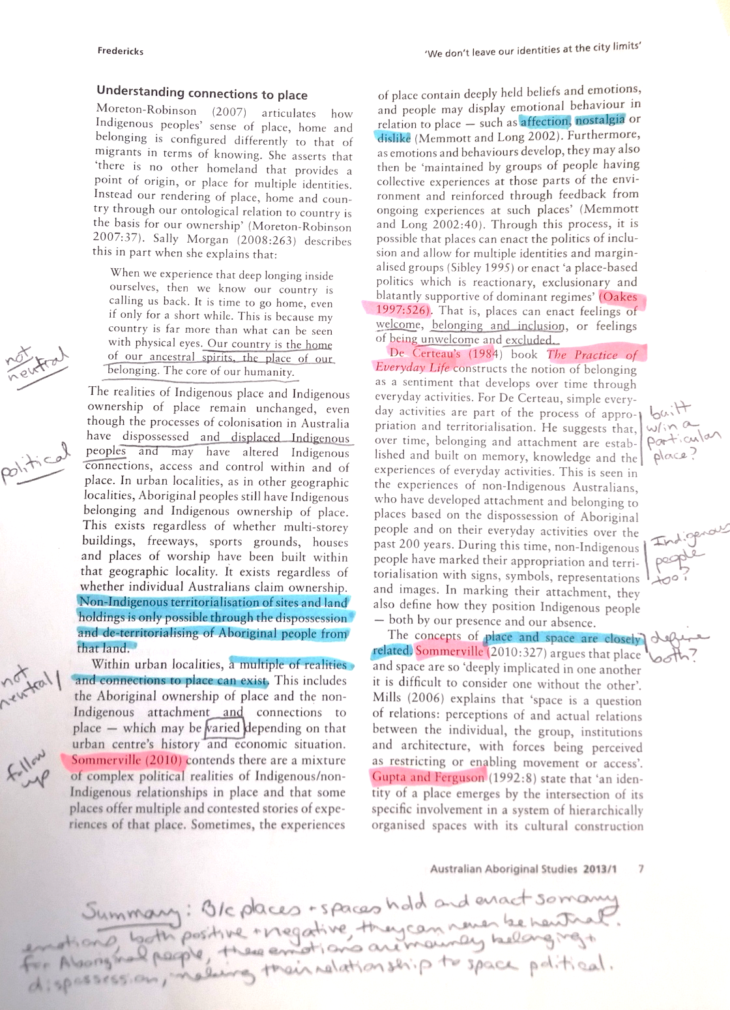
Adapted Cornell Method
Cue column: for comments/definitions/connections/items to follow up.
Notes: Mark key points/ideas/themes/ theories/theorists
Highlight, underline, circle, whatever!
Use bottom and top margins for summary section and longer notes.
Notes:
KM: note-taking should not just identify major points, but aim to analyse and summarise
Can adopt the Cornell system to many situations
End result should be a summary – this summary will be useful for your work later.
Write while you read.

Slide 38
1. Search
How is the article laid out? What are the sections?
2. Skim
What are the key ideas in the abstract, key words, intro, headings, topic sentences?
3. Select
Which sections or paragraphs are relevant to me?
4. Study
Closely read the relevant parts and take notes
PURPOSE – Why am I reading this? What information do I need? How much time and energy is it worth?

Slide 39


anu.edu.au/academicskills
Notes:
Come see us!

